Slide 1
An Analysis of the Gap Junction Beta 1 Protein

Slide 2
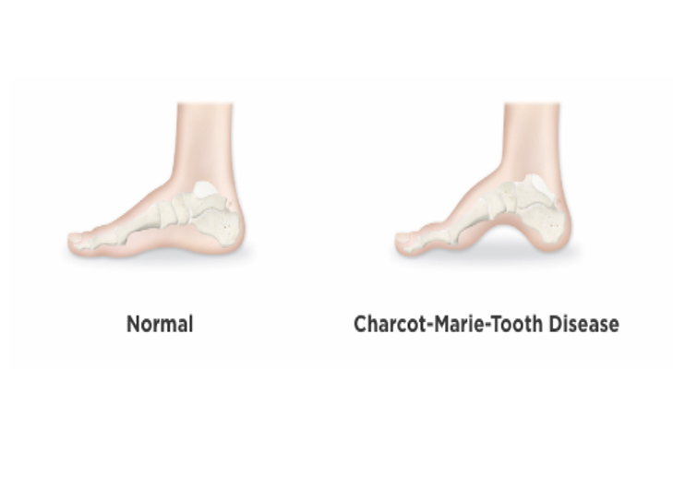
Charcot Marie Tooth Disease X Dominant 1
What is CMTX1?
Neurological disorder
What are the Symptoms?
Muscle weakness and atrophy
What causes CMTX1 and occurrence of it?
Mutations in GJB1 (Cx32)
%10-%20 of 30 out of 100.000
(“What Is Charcot-Marie-Tooth Disease?”)

Slide 3
General Mutation Types (that cause CMTX1)
Not being synthesized
Synthesized in limited amounts
Does not get properly transported
Unable to form gap junctions
Limited number of channels

Slide 4
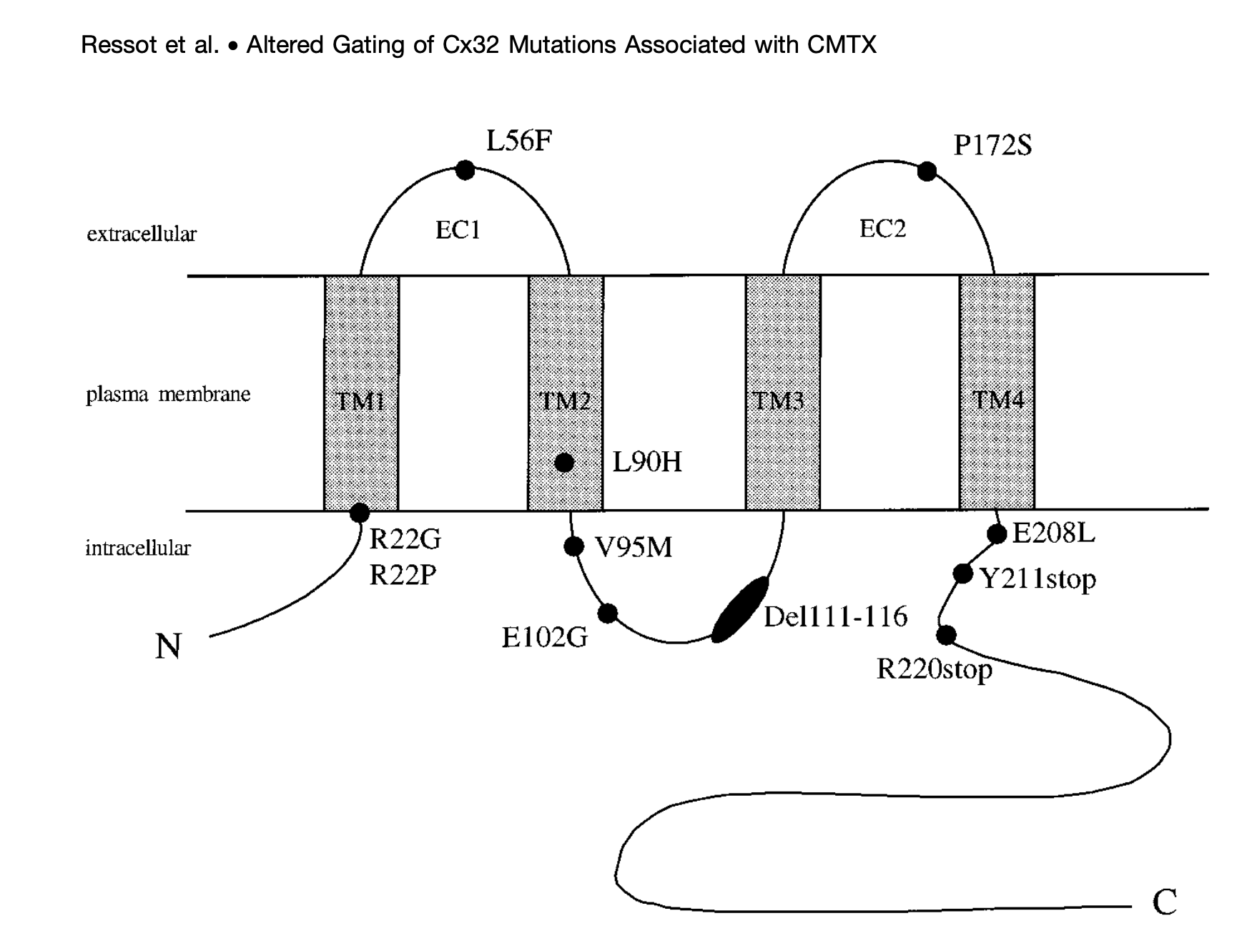
Gap Junction Beta 1 Protein Topology
First Cytoplasmic Region (1-22)
First Transmembrane Region (23-45)
First Extracellular Region (46-75)
Second Transmembrane Region (76-95)
Second Cytoplasmic Region (96-130)
Third Transmembrane Region (131-153)
Second Extracellular Region (154-191)
Fourth Transmembrane Region (192-214)
Cytoplasmic Tail (215-283)
(Sohl et al)

Slide 5
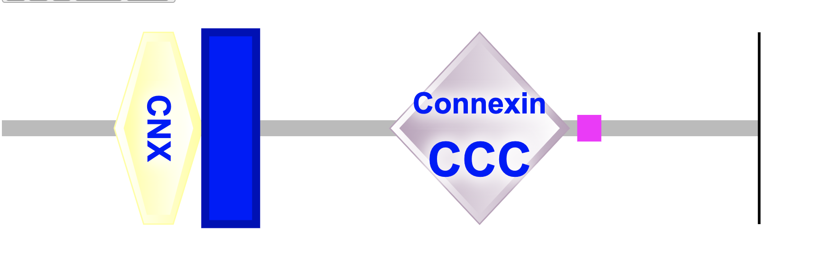
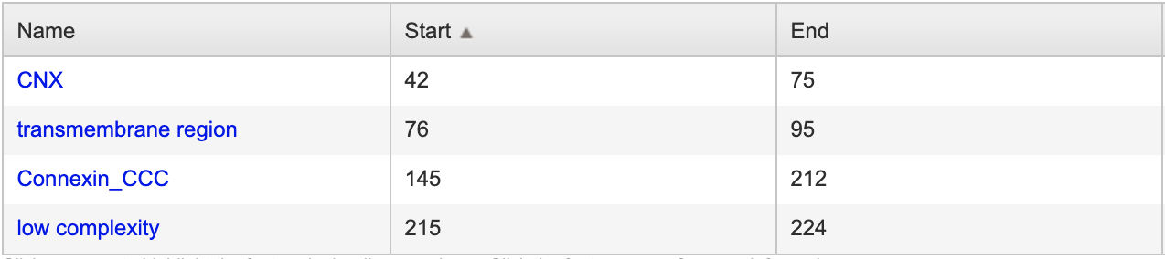
Gap Junction Beta 1 Protein Domains
“Domain Architecture Analysis.” SMART, smart.embl- heidelberg.de/smart/show_motifs.pl?ID=P08034.

Slide 6
Purpose
The aim of this project is to identify the most conserved domains of the GJB1 protein in order to determine the most conserved residues, on which pathogenic mutations can occur, and predict possible mutations on the protein.

Slide 7






Materials and Methods
UniProt
BLAST
MSAViewer
MAFFT
MEGA
FigTree
Python
R (ggplot)
Meta SNP
GenBank

Slide 8
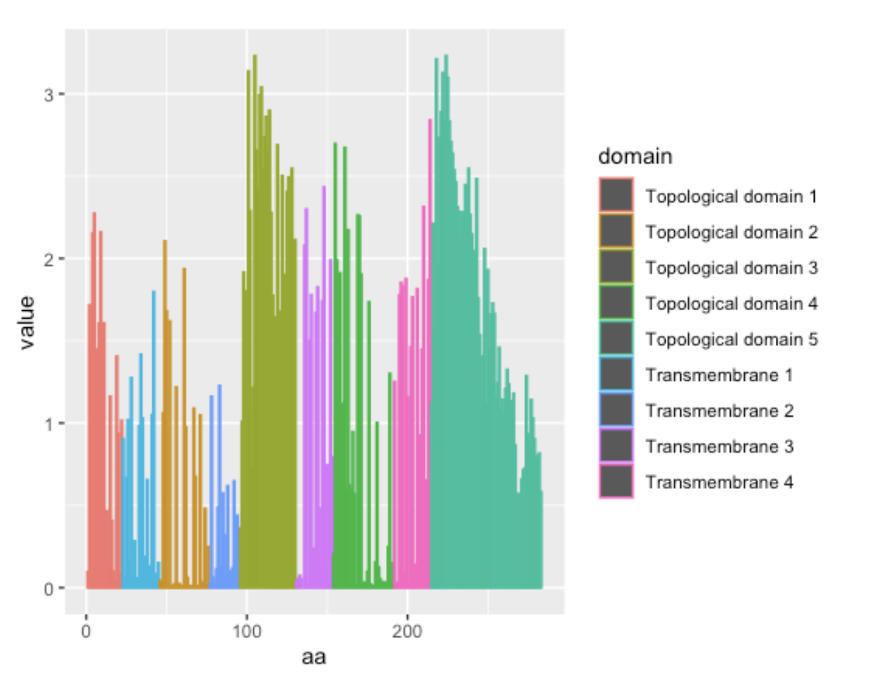
Results - Shannon Entropy
Cytoplasmic | 0.954
Transmembrane | 0.534
Extracellular | 0.469
Transmembrane | 0.347
Cytoplasmic | 1.948
Transmembrane | 0.885
Extracellular | 0.746
Transmembrane | 1.100
Cytoplasmic | 1.677

Slide 9
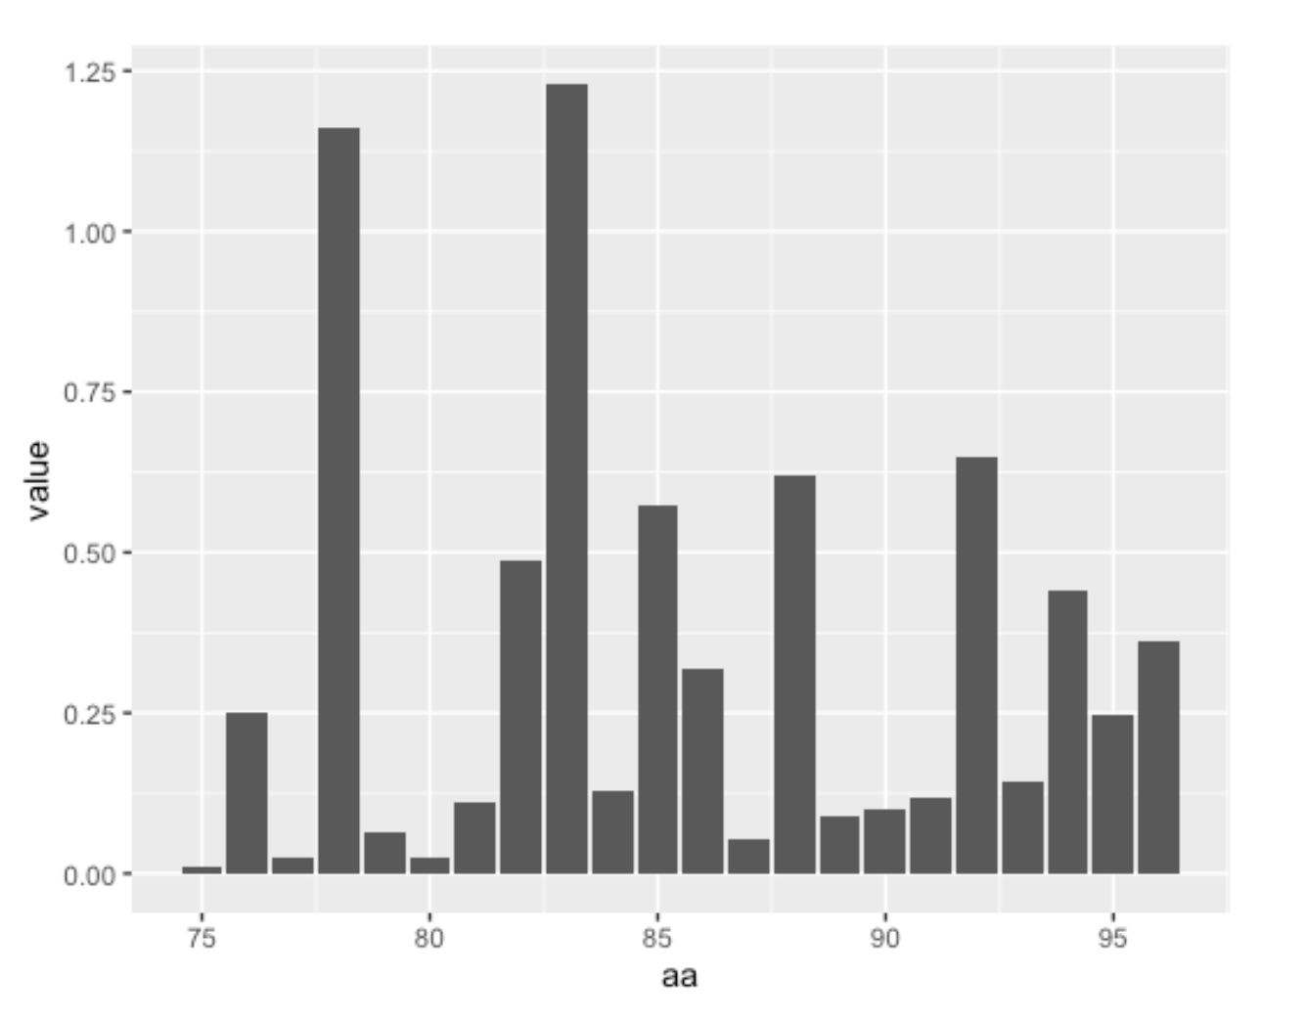
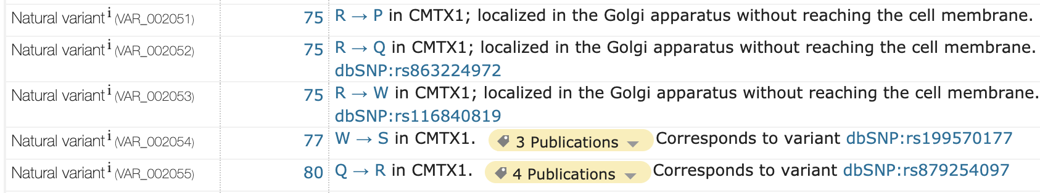
UniProt ConsortiumEuropean Bioinformatics InstituteProtein Information ResourceSIB Swiss Institute of Bioinformatics. “Gap Junction Beta-1 Protein.” UniProt ConsortiumEuropean Bioinformatics InstituteProtein Information ResourceSIB Swiss Institute of Bioinformatics, 2 Dec. 2020, www.uniprot.org/uniprot/P08034.

Slide 10
Shannon Entropy-Additional Findings
No reported mutation for the 96th residue on UniProt.
Residue 135 had an entropy score of 0.
Residue 136 had an entropy score of 2.07.
UniProt ConsortiumEuropean Bioinformatics InstituteProtein Information ResourceSIB Swiss Institute of Bioinformatics. “Gap Junction Beta-1 Protein.” UniProt ConsortiumEuropean Bioinformatics InstituteProtein Information ResourceSIB Swiss Institute of Bioinformatics, 2 Dec. 2020, www.uniprot.org/uniprot/P08034.

Slide 11

Results - Mutations Prediction
Predicting protein stability against mutations
Several tools are available
Used Meta-SNP
Web-based tool by University of Alabama, Birmingham
Binary Classification -> Disease or Polymorphic non-synonymous SNVs
Accuracy %79

Slide 12
Results - Mutations Prediction
Control Predictions
Mutations | Prediction
R75P | 0.923
R75Q | 0.838
S85C | 0.601
V136A | 0.592

Slide 13
Results - Mutations Prediction
Model Predictions
Mutations | Prediction
Y135A | 0.925
Y135C | 0.961
Y135E | 0.950
Y135K | 0.952
Y135S | 0.927

Slide 14
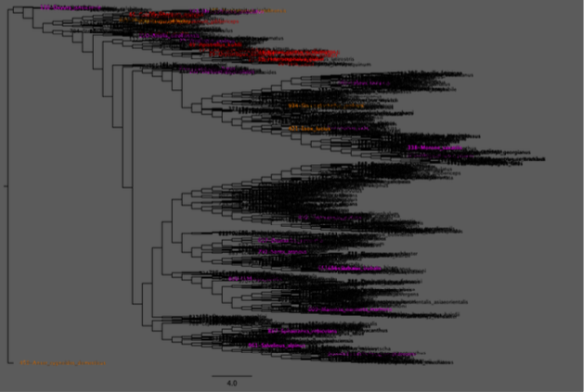
Phylogenetic Tree
Aligned with MAFFT
Pattern detected manually
Python scripts to separate groups
FigTree to coloured

Slide 15
Phylogenetic Tree
Group 1 -> 883 Sequences
Coloured with magenta
Mostly placed in bottom trees
Started with 54 gaps and M
Dominant group

Slide 16
Phylogenetic Tree
Group 2 -> 85 Sequences
Coloured with red
Mostly placed in upper trees
Started with 3 gaps and later M

Slide 17
Phylogenetic Tree
Group 3 -> 6 Sequences
Coloured with orange
Could placed in anywhere
Any pattern is not determined
Has outgroup species -> anser cygnoides domesticus (bird)

Slide 18
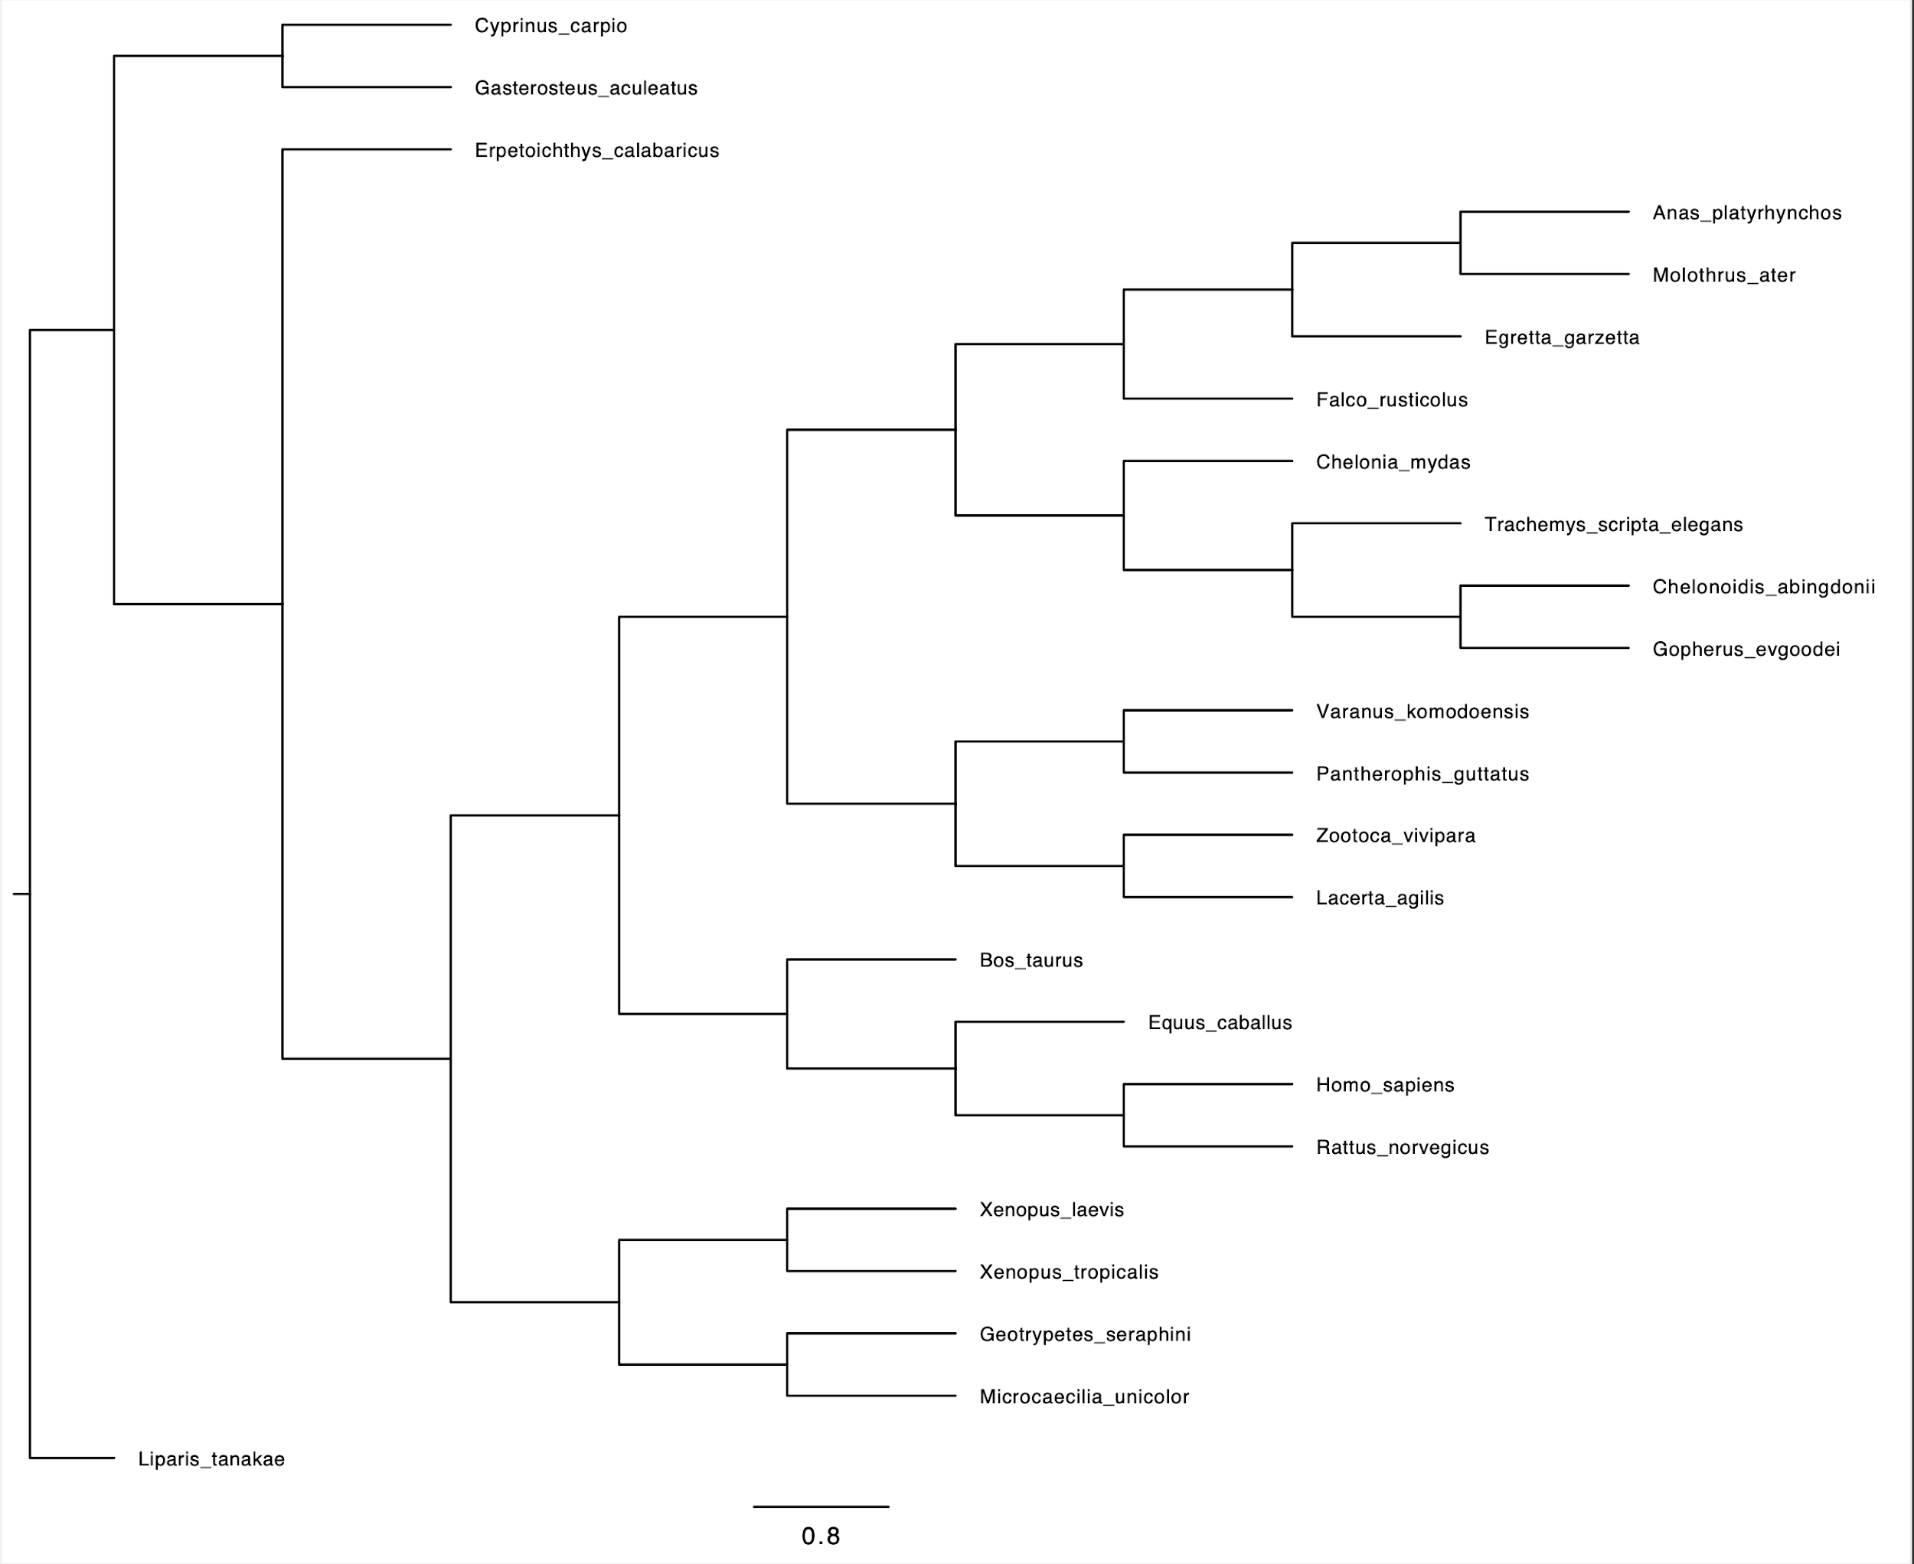
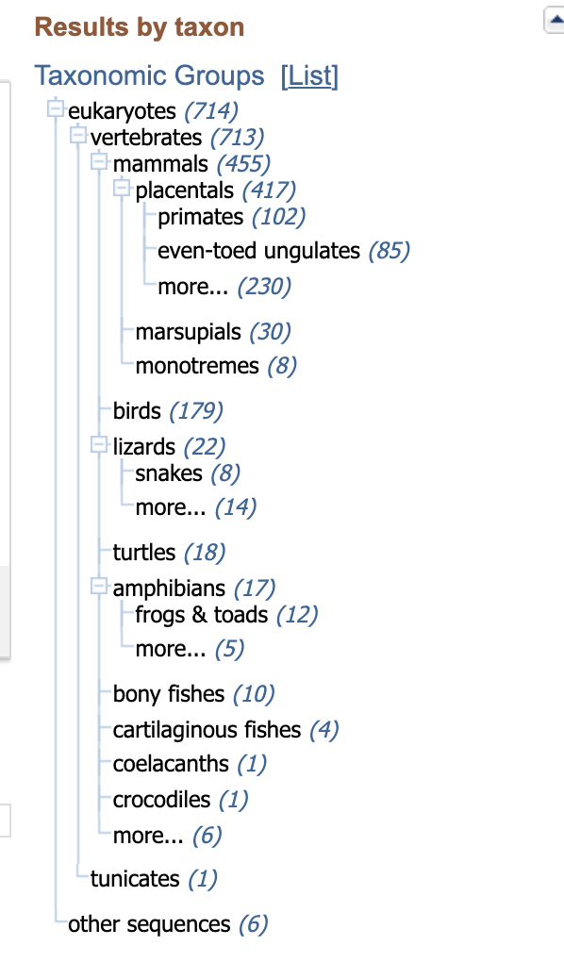
Small Sample Maximum Likelihood Tree
Fish
Birds
Turtles
Lizards
Mammals
Amphibians
“GenBank Overview.” National Center for Biotechnology Information, U.S. National Library of Medicine, www.ncbi.nlm.nih.gov/genbank/. .

Slide 19
Discussion
Conserved Regions
Most conserved region → second transmembrane
Highly conserved residues → 75, 77, 80 → mutations are reported in UniProt
Also conserved → 135th

Slide 20
Discussion
Mutations
No publications about 135th residue (according to UniProt)
Meta-SNP said Singular Nucleotide Variant → ~90% labeled as disease
Further studies needed -> could cause CMTX1 disease (critical residue)

Slide 21
Discussion
Phylogenetic Trees
Deletion (?) → gap in beginning
Consist of three groups
Same species located on same node in small tree

Slide 22
References
Abrams, Charles K. “GJB1 Disorders: Charcot Marie Tooth Neuropathy (CMT1X) and Central Nervous System Phenotypes.” GeneReviews® [Internet]., U.S. National Library of Medicine, 20 Feb. 2020, www.ncbi.nlm.nih.gov/books/NBK1374/.
Bortolozzi, Mario. “What's the Function of Connexin 32 in the Peripheral Nervous System?” Frontiers in Molecular Neuroscience, Frontiers Media S.A., 10 July 2018, www.ncbi.nlm.nih.gov/pmc/articles/PMC6048289/.
“Diseases - CMT - Types of CMTX.” Muscular Dystrophy Association, 28 Jan. 2020, www.mda.org/disease/charcot-marie-tooth/types/cmtx.
“Domain Architecture Analysis.” SMART, smart.embl- heidelberg.de/smart/show_motifs.pl?ID=P08034.
“GenBank Overview.” National Center for Biotechnology Information, U.S. National Library of Medicine, www.ncbi.nlm.nih.gov/genbank/.
Sohl, G. and K. Willecke. "Gap Junctions and the Connexin Protein Family." Cardiovascular Research, vol. 62, no. 2, 2004, pp. 228-232, doi:10.1016/j.cardiores.2003.11.013.
UniProt ConsortiumEuropean Bioinformatics InstituteProtein Information ResourceSIB Swiss Institute of Bioinformatics. “Gap Junction Beta-1 Protein.” UniProt ConsortiumEuropean Bioinformatics InstituteProtein Information ResourceSIB Swiss Institute of Bioinformatics, 2 Dec. 2020, www.uniprot.org/uniprot/P08034.
What Is Charcot-Marie-Tooth Disease?: JuniOrtho™. 14 Oct. 2020, www.juniortho.club/patient-support/what-is-charcot-marie-tooth-disease-2/.

